Slide 1


Introduction to Software Business Product Management
Week 2 Day 3
Led by: Emily Crose
for
Oakland University

Slide 2
Day 2 Recap

Slide 3

Questions From Day 2?

Slide 4
Terms To Listen For
Application Programming Interface (API)
Enables automated, programmatic retrieval of information using a standard framework.
Authentication
Refers to the process of verifying a user’s identity.
Rate-Limit
How many requests can occur at a given time.

Slide 5


Purdue Model Explained

Slide 6
Purdue Mode, What Is It?
A method of arranging and segmenting networked operational technology (OT) devices.

Slide 7
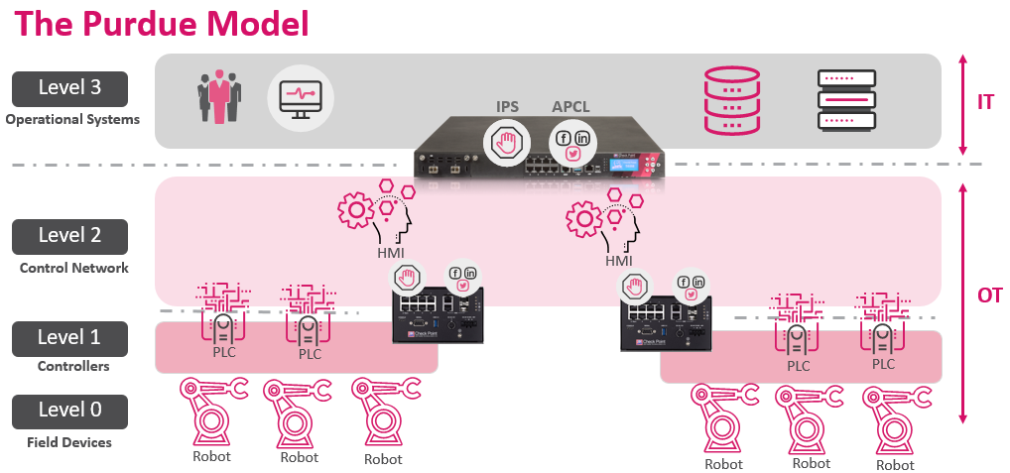

Slide 8
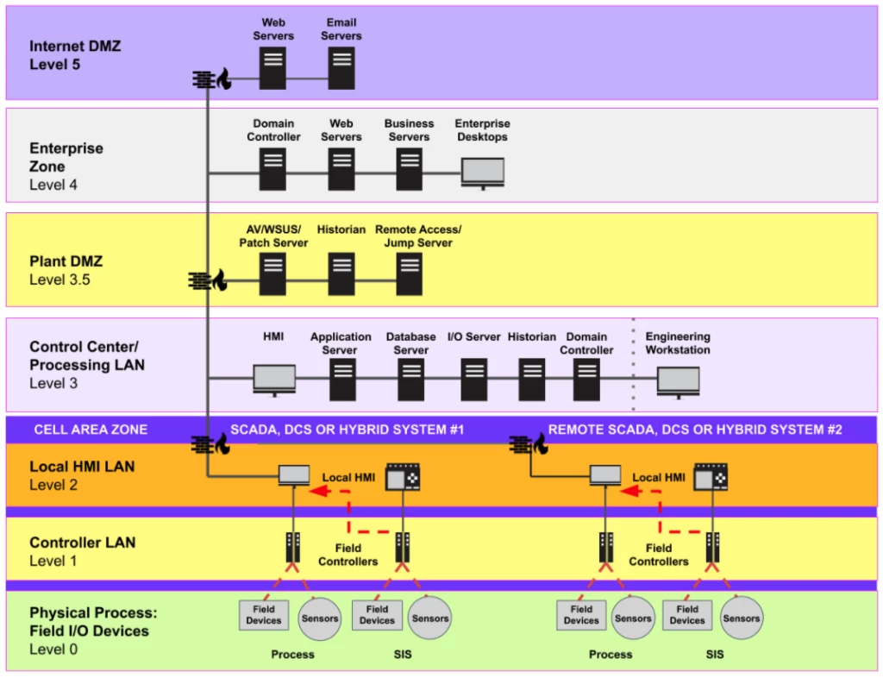

Slide 9
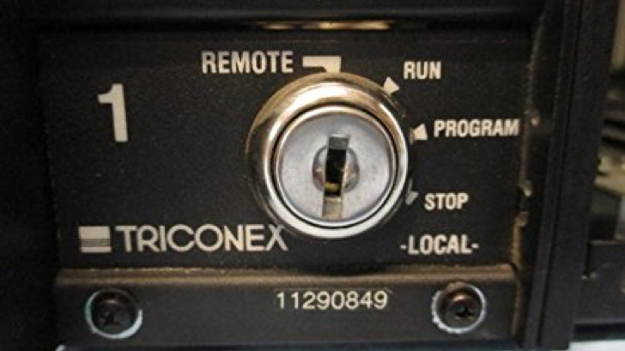
Anatomy Of A Complex OT Attack

Slide 10


Slide 11
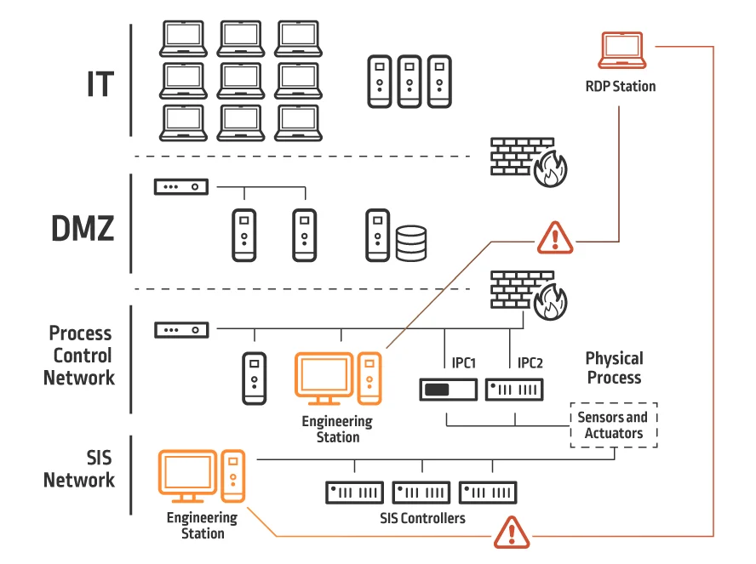
Inside The Victim Network

Slide 12
Who Cares About This?

Slide 13


Slide 14
How Does Software Fit In?

Slide 15

Can This Apply To Cars?

Slide 16
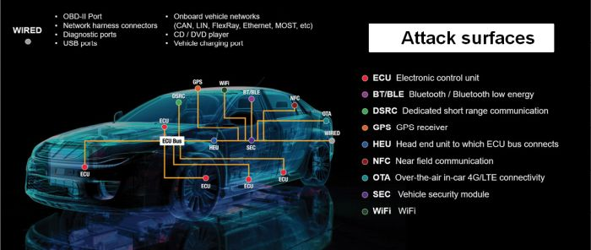
Car-Based Attack Surface

Slide 17
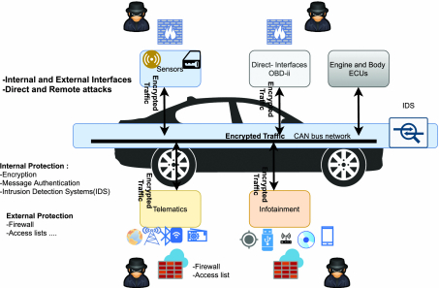
Local Car Network

Slide 18
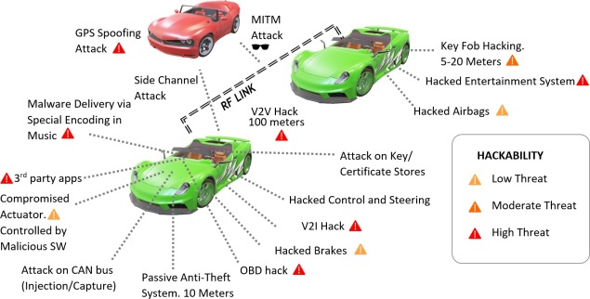
Popular Car Attack Surfaces

Slide 19
Application Programming Interfaces (APIs)
What do they do for applications?
When would we want to use an API?

Slide 20
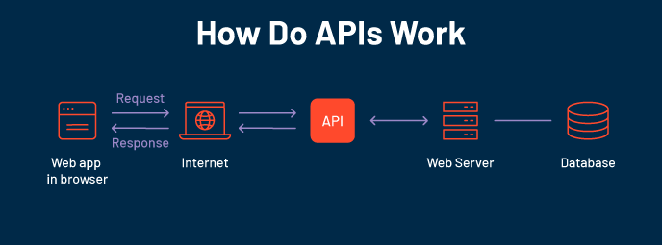

Slide 21
Familiar APIs
Rpresentational State Transfer (REST or RESTful) API
Fast
Reliable
Widely adopted
Simple!
Simple Object Access Protocol (SOAP)
Used in some OT network appliances
Browser API
iOS/Android API
Allows developers the tools they need to utilize local resources in their own programs
Notification API calls
Camera activation
Media integration

Slide 22
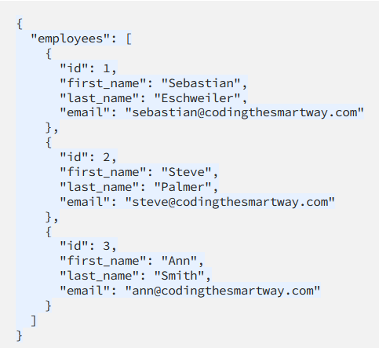
Notes:
Let’s take a look at a JSON form providing us information through an API interface. So when we use an API to retrieve information, we will typically be grabbing that information from a formatted file like a JSON file. We can see from this JSON file that actually this looks kind of like a database file.

Slide 23
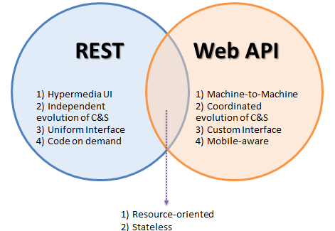
Popular API Frameworks

Slide 24

HTTP/Web API

Slide 25
HTTP API Verbs
HTTP
GET
POST
PUT
DELETE

Slide 26
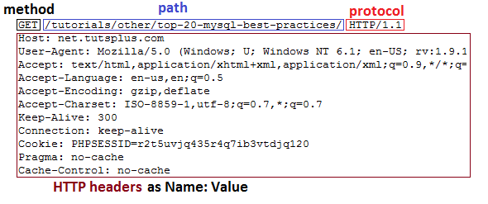
HTTP GET Header

Slide 27
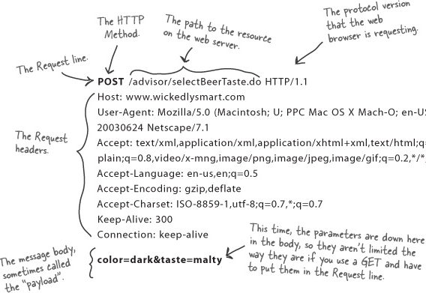
HTTP POST Header

Slide 28
Weather API
https://rapidapi.com/weatherapi/api/weatherapi-com

Slide 29
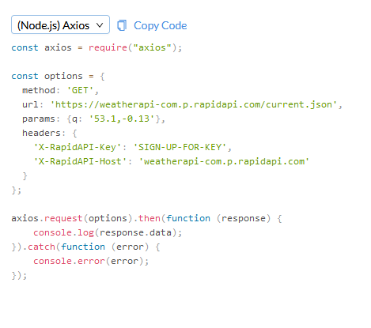
Notes:
So let’s take a look at what an API actually looks like in practice.

Slide 30
Working With APIs
Can be programmed
Can be used in a raw request

Slide 31
Programming Mobile Apps w/APIs
Android
Kotlin
Apple iOS
SWIFT
Both of these have access to device APIs!

Slide 32
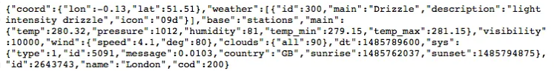
Mobile Device API Example

Slide 33

Securing APIs

Slide 34

Why Do We Need API Keys?
Account verification
Who is requesting what information?
Rate limiting
Avoid denial of service
Permissions
What do we want to allow certain people to see?

Slide 35
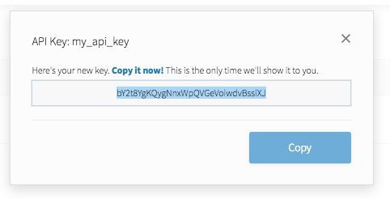
API Key
Notes:
API keys are meant to be kept secret. Why? Because they include information related to one specific account.

Slide 36


What is Oauth?

Slide 37
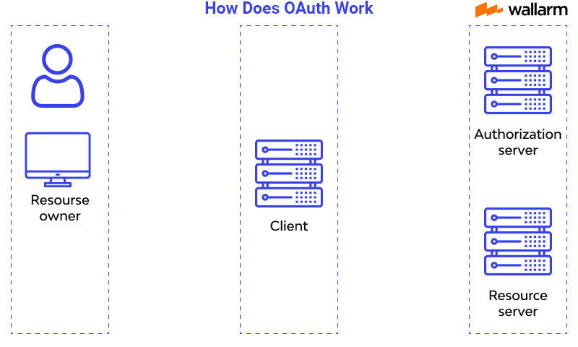
How does oauth work?

Slide 38
Let’s Make A Github Account!
https://github.com

Slide 39

Question or clarifications?

Slide 40

Questions?

Slide 41

Review Day 2

Slide 42

Preview day 3

